Slide 1
COVID-19 RECOGNITION FROM CHEST X-RAY IMAGES USING DEEP LEARNING
PROJECT DOMAIN: PROJECT GUIDE:
DEEP LEARNING -PYTHON DR.L.JABASHEELA, M.CA., M.E., Ph.D.,
BATCH NO:A9 PROJECT MEMBERS:
KEERTHANA V-211418104119
LAKSHMIPRIYA B-211418104137
MADHUMITHA CT-211418104142

Slide 2
INTRODUCTION
The corona-virus 2019(COVID-19), which first occurs in wuhan city of china in december 2019, spread quickly around the world and became a plague. Due to the regular increase in cases, the number of COVID-19 test kits available in the hospital is minimal.
Since an automated detection system is needed as an alternative diagnosis to prevent covid-19 from spreading among people. It is necessary to detect the positive cases as early as possible so as to prevent the further spread of this disease.
Application of convolutional neural networks (cnn) techniques coupled with medical imaging can be helpful for the accurate detection of this disease. In this project A new model for automated COVID-19 detection using raw chest x-ray images is used.
The model is developed to supply accurate diagnosis for binary classification (covid vs. Non-covid). We introduced convolutional layers and implemented different filtering on each layer

Slide 3
AUTHORS | TITLE OF THE PAPER | ALGORITHMS USED | FINDINGS
Mohammad rahimzadeh , Abolfazl attar, Elsevier[informatics in medicine unlocked],2020. | A modified deep convolutional neural network for detecting covid-19 and pneumonia from chest x-ray images based on the concatenation of xception and resnet. | neural network which is a concatenation of the Xception and Resnet network. | This network achieved the best accuracy by utilizing multiple features extracted by two robust networks.
S. Tabik , A. Gómez-Ríos, J. L. Martín-Rodríguez, I. Sevillano-García, M. Rey-Area, D. Charte, E. Guirado, J. L. Suárez, J. Luengo, M. A. Valero-González, P. García-Villanova, E. Olmedo-Sánchez, and F. Herrera. | COVIDGR Dataset and COVID-SDNet Methodology for Predicting COVID-19 based on Chest X-Ray Images. | CNN | They proposed COVID Smart Data based Network (COVID-SDNet) methodology which improves the generalization capacity of COVID-classification models.
Boran sekeroglu and Ilker Ozsahin, Original research,2020 | Detection of COVID-19 from chest x-ray images using convolutional neural networks | Convnet experiments, statistical measurement experiments, and transfer learning experiments. | Several categorized experiments were performed to evaluate the efficiency of the convnet on the considered image.
Pillalamarry Mahesh, Yakkala Gnana Prathyusha, Botlagunta Sahithi, S Nagendram, Journal of Physics: Conference Series,2020. | Covid-19 Detection from Chest X-Ray using Convolution Neural Networks | Convolutional neural network(CNN) | There are different ways to diagnose the COVID-19, but they are cost-effective and increasing the time taken to produce, buy using chest x-ray we can reduce cost and result in Time.
Parag Chatterjee , Mainak Biswas, and Arnab Kumar Das, Journal of Physics,2020. | Specialized covid-19 detection techniques with machine learning. | Convolutional neural network architectures are used | It uses the technique called transfer learning for automatic detection of the COVID-19 disease.

Slide 4
Moutaz Alazab, Albara Awajan, Abdelwadood Mesleh, Ajith Abraham, Salah Alhyari, International Journal of Computer Information Systems and Industrial Management Applications,2020 | COVID-19 Prediction and Detection Using Deep Learning. | CNN | COVID-19 detector obtained better results when using augmentation. A better training process was achieved as the gap between the training and validation became smaller.
Wentao Zhao, Wei Jiang & Xinguo Qiu, Scientifc Reports,2020. | Deep learning for COVID‐19 detection based on CT images. | Transfer learning method to improve the performance of CNN is used. | The Grad-Cam visualization techniques is established to explore and understand the covid affected area in the CT image.
S. V. Kogilavani , J. Prabhu,R. Sandhiya,M. Sandeep Kumar,UmaShankar Subramaniam, Alagar Karthick,M. Muhibbullah ,Hindawi [computational and mathematical methods in medicine],2021 | COVID-19 detection based on lung ct scan using deep | Deep learning architectures, namely,VGG16, DenseNet , MobileNet , Xception , Efficient Net and NASNet are used | The image filtering preprocessing technique is used to filter the size of all input samples.
Joy Iong-Zong Chen, Journal of ISMAC,2021. | Design of Accurate Classification of COVID-19 Disease in X-Ray Images Using Deep Learning Approach | CNN and Histogram-Oriented Gradients (HOG) methodology. | The analysis of 10 fold cross-validation with confusion metrics can also take place in this research work to detect various diseases caused due to lung infection such as Pneumonia corona virus positive or negative
Amir Rehman, Muhammad Azhar Iqbal, Huanlai Xing and Irfan Ahmed, Applied sciences,2021. | COVID-19 Detection Empowered with Machine Learning and Deep Learning Techniques: A Systematic Review. | ML/DL techniques | It can be stated that radiological X-ray image-based models worked better than the C.T. image-based models.

Slide 5
PROBLEM DEFINITION
The current COVID-19 screening method is RT-PCR.
This is the first method that is used by many practitioners/doctors to diagnose COVID-19.
But the problem with this method is that it is very time-consuming and the results obtained from this method take few days to weeks.
This creates a major challenge with less equipped clinics or hospitals.
When compared to PCR techniques, chest X-Ray(CXR) methods have many advantages, that is, they are easily available and cheap.

Slide 6
DEVELOPMENT ENVIRONMENT
SOFTWARE SPECIFICATION
OPERATING SYSTEM : WINDOWS 10 (64 BIT)
PROGRAMMING LANFUAGE : PYTHON 3.7
TOOLS : ANACONDA (JUPYTER NOTE BOOK IDE)
HARDWARE SPECIFICATION
Processor - I5
Speed - 3 GHz
RAM - 4GB (min)
Hard Disk - 500 GB

Slide 7
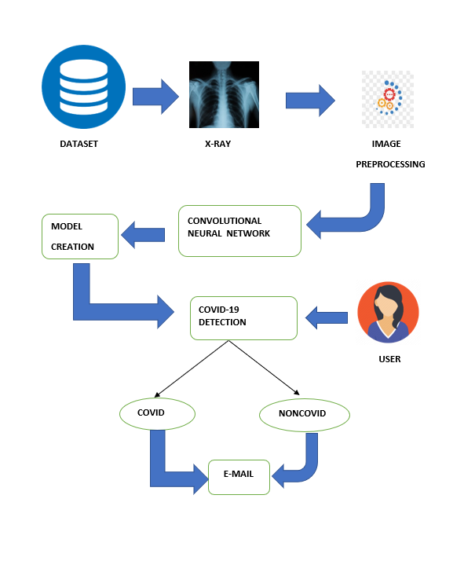
SYSTEM ARCHITECTURE

Slide 8
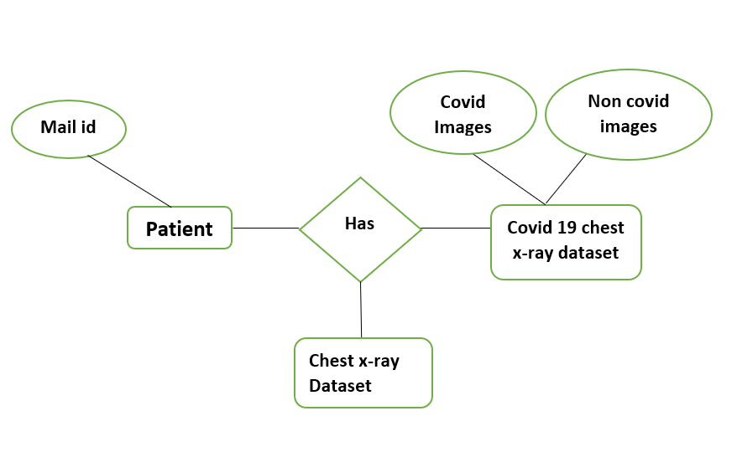
SYSTEM DESIGN
ER DIAGRAM

Slide 9
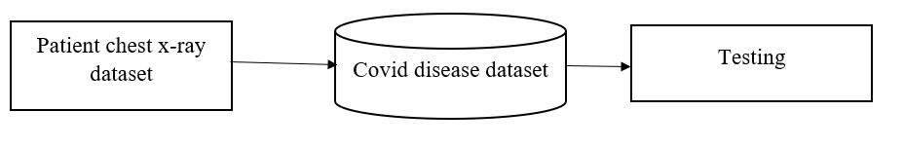
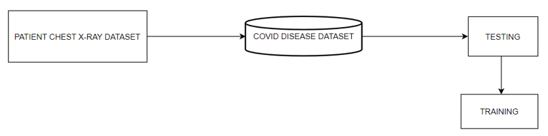
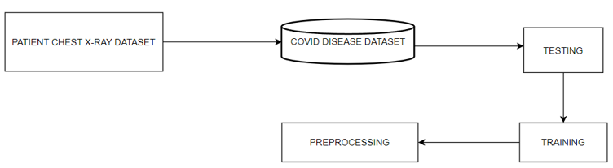
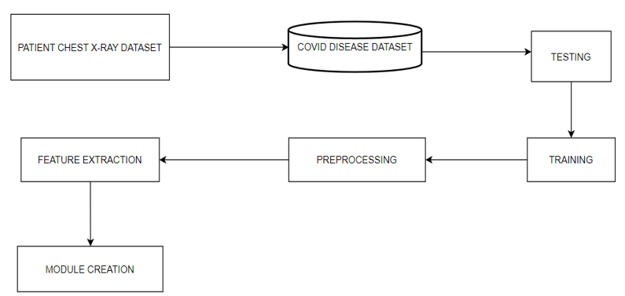
DFD DIAGRAM
Level 0 Level 1
Level 2 Level 3

Slide 10
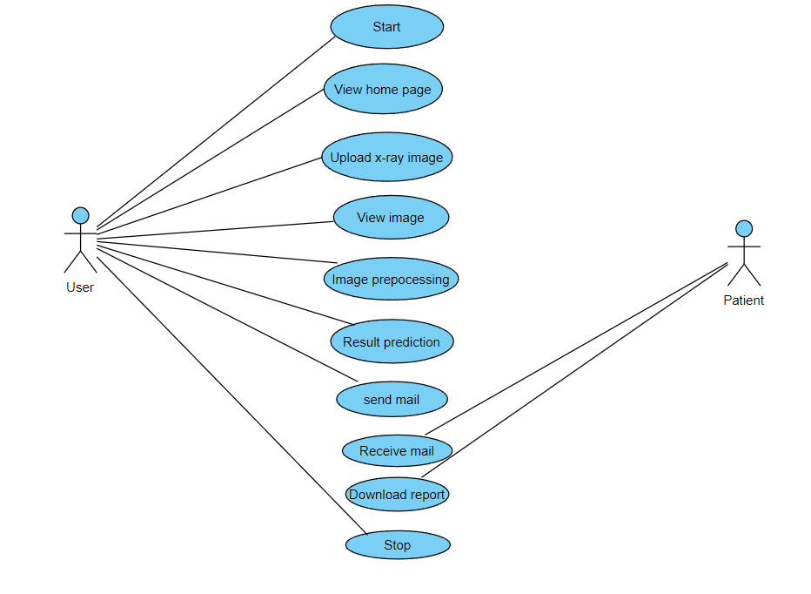
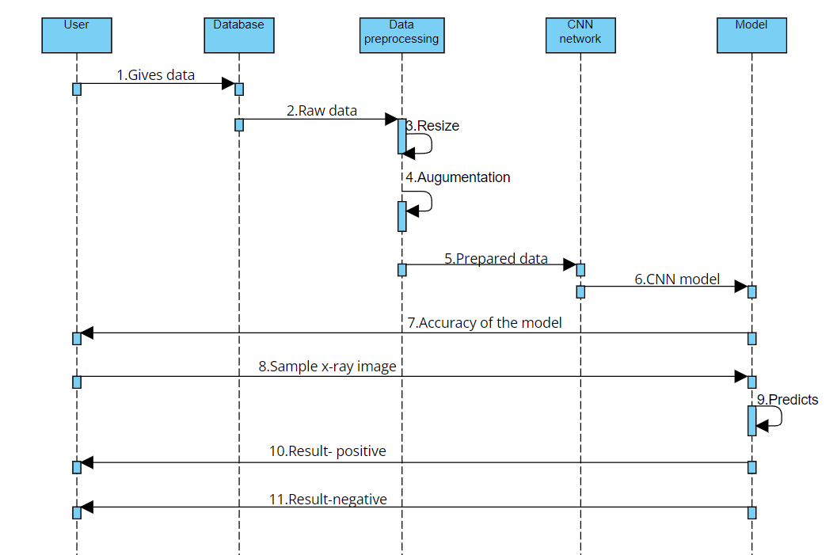
UML DIGRAMS
USECASE DIAGRAM SEQUENCE DIAGRAM

Slide 11
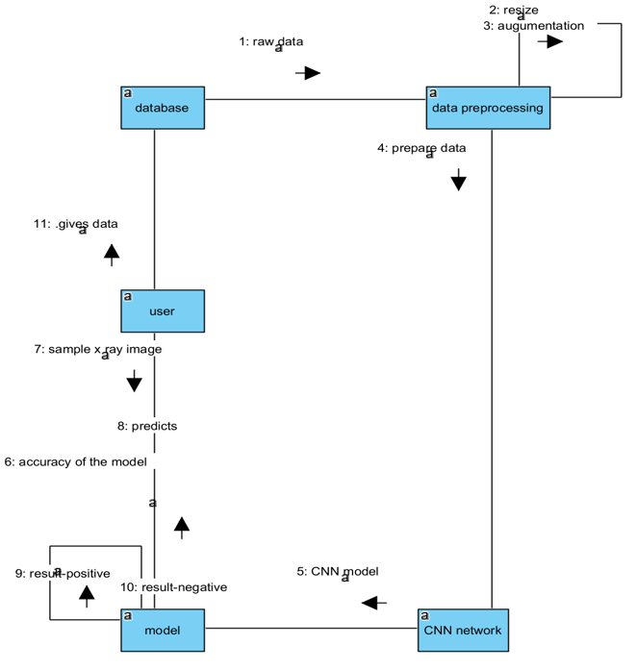
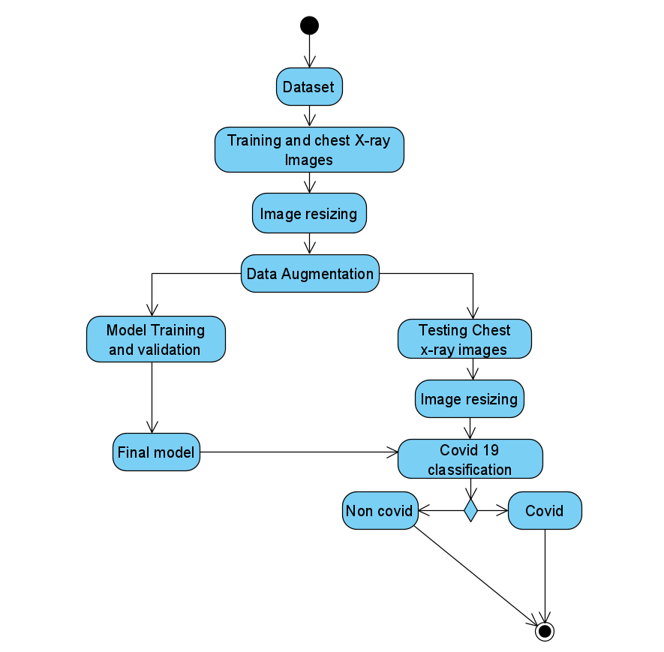
COLLABORATION DIAGRAM ACTIVITY DIAGRAM

Slide 12
MODULE DESCRIPTION
The following are the list of modules of covid 19 recognition using chest x-ray:
Image Acquisition
Data Pre-processing
Train the model
Evaluation of model
Send mail

Slide 13
IMAGE ACQUISITION
The acquisition of photographs is the initial step. The computer must learn by doing in order to create a classification model.
To recognise an object, the computer must view a large number of photos. Deep learning models can also be trained with other forms of data, such as time series data and voice data.
Images will be the relevant data for detecting covid. A chest X-ray image is one example of a possible image. This stage produces photos that will be used to train the model later.
The project's data was obtained from an open source Github repository. Chest X-ray images (1000 images) were obtained from: https://github.com/ieee8023/covid-chestxray-dataset.
On Chest X-ray, VGG16, ResNet 50, Inception V3, and Xception were trained.

Slide 14
DATA PRE-PROCESSING
In the deep learning process, image pre-processing is a very common and beneficial technique that not only increases the size of the original dataset but also enriches the information implicit in it.
The dataset contains images of various sizes. They can be fed into deep learning models for training after being resized to a fixed size. The images are resized to 224 x 224 px, which is regarded as the ideal size for the ResNet50 model
The X-ray images have been resized to 224 224. As previously stated, we used a powerful image enhancement method known as Dynamic Histogram Equalization (DHE) to improve the quality of images before they were fed into the CNN model.
Histogram Equalization (HE), which refers to mapping from the initial narrow pixel levels to a larger extent and improves image enhancement, is a widely used technique in image processing.
The HE technique is used to convert the grey levels of an image by using the cumulative effort function globally, but it always results in the loss of elaboration information in images, resulting in poor image quality.
This popular image contrast enhancement method could improve image contrast in a variety of applications, including MRI, X-rays, and CT.

Slide 15
TRAIN MODEL
After the model has been built, the next step is to train it. Image Data Generator is designed to train models on modified images, such as those with different angles, flips, rotations, or shifts
We were successful in developing an image-recognition artificial convolutional neural network. Separate the dataset into two sections: training and testing.
Finally, we will create and train the model using the training dataset. To learn CXR modality-specific feature representations, a custom CNN and a selection of pretrained CNN models are trained on a large-scale selection of CXRs.
The acquired knowledge is then transferred and fine-tuned in order to classify covid and non covid CXRs. We use the advantages of modality-specific knowledge transfer, iterative pruning, and ensemble strategies to reduce model complexity and improve the DL model's robustness, generalization, and inference capability.
With a batch size of 32 images, the model is trained for 500 epochs. Eighty percent of the images were used to train the models, with the remaining twenty percent used to test the models' accuracy.

Slide 16
EVALUATION OF MODEL
Model testing is possible after the model has been trained. This step retrieves a test set of data. Because the model has never seen this set of data before, its true correctness will be confirmed.
Finally, the model that has been saved can be used in the real world. This step is known as model evaluation. This means that the model can be used with new data. Several evaluation metrics, such as accuracy, precision, recall, and F1 score, are described. Four indices, True Positive, True Negative, False Positive, False Negative, are used to analyse and identify model performance based on model outputs.
The True Positive indicates that the model has signed the chest X-ray images that have covid as covid as well. If the chest X-ray images do not show covid as well as the model predicts, this is a True Negative.
The precision rate was always used to estimate how much the number of images that are truly covid accounted for in the total number of positive covid examples. That is, covid images must be identified in practical clinical diagnoses, so the precision rate is critical. Most of the time, the higher the precision rate, the lower the recall rate. As a result, the F1 score rate is widely regarded as an appropriate criterion.

Slide 17
SEND MAIL
After the evaluation of the model, the results can be sent to the user mail id.
There will be a send mail option visible in the result page through which the result is sent to the user as a report of covid or non-covid.

Slide 18
PERFORMANCE ANALYSIS
There are several methods to evaluate a model’s performance. Accuracy, precision, recall, and F-score are the measures considered to estimate chest X-ray images.
PRECISION:
Precision is defined as the ratio of correctly predicted positive cases. This metric is a measure of exactness, which is calculated as the percentage of positive predictions of COVID-19 that were true positives divided by the number of predicted positives.
Precision =TP/TP + FP
RECALL:
The ratio of accurately detected positive cases is the recall. This metric is a measure of completeness, which is calculated as the percentage of positives that were correctly identified as true positives divided by the number of actual positives.
Recall = TP/TP + FN
F1-SCORE:
The F1-score is the harmonic mean of precision and recall. This is a combination of precision and recall that provides a significant measure for a test dataset that includes an imbalanced class.
F1 score = 2 x [Precision x Recall/Precision + Recall]

Slide 19
RESULTS
The COVID-19 is highly contagious, so controlling its transmission path effectively is crucial.
The proposed work uses different deep learning algorithms (Xception, Inception, VGG, Resnet) to identify covid 19 from x-ray images.
The training and testing phases are preceded by a preprocessing phase that includes data augmentation. In order to make an accurate prediction, evaluation metrics such as Precision,Recall,F1-score are used.
Research findings indicated that Convolutional Neural Networks have the latent to detect respiratory diseases with the best accuracy, although a large amount images are needed, achieves an accuracy of 95% train accuracy and 98% of validation accuracy. By improving the networks, we can achieve 100% accuracy.

Slide 20

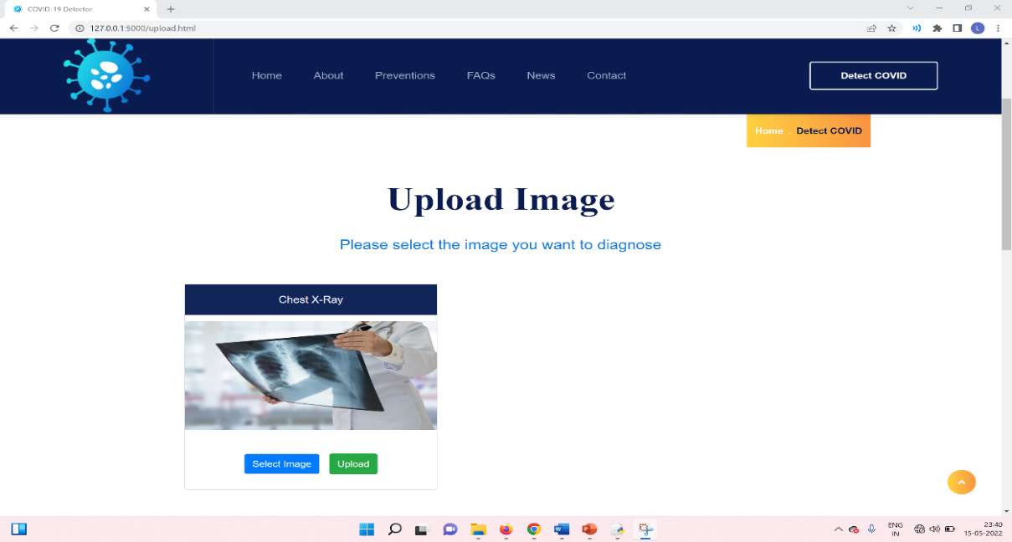
SCREENSHOTS
HOME PAGE UPLOAD IMAGE

Slide 21
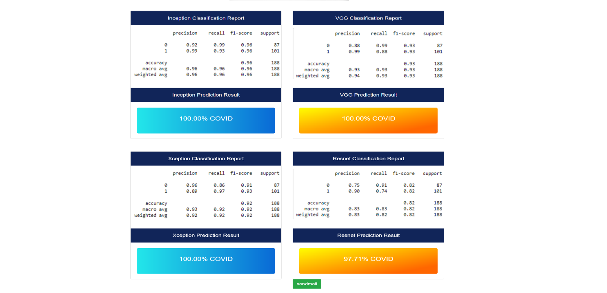

RESULT PAGE RECEIVED MAIL PAGE

Slide 22
CONCLUSION
COVID-19 is a disease caused by the SARS-CoV-2 virus, which was found in Wuhan, China, in December 2019. It is very contagious and has spread rapidly over the world. COVID-19 is most commonly associated with respiratory symptoms that resemble a cold, flu, or pneumonia.
Despite the fact that vaccines were launched at the beginning of 2021, there is a pressing need for quick and precise instruments to increase the healthcare system's efficiency.
Our method successfully separated photos into two categories: COVID-19 positive and COVID-19 negative. Early detection of the novel coronavirus is critical to preventing the virus from spreading to others.
We develop a deep transfer learning system that analyses chest X-ray pictures from patients with COVID-19 and patients without COVID-19 to detect the condition automatically. Doctors have limited time due to the enormous number of patients treated outside or in emergencies, and computer-aided analysis could save lives through early screening and proper therapy.
This is especially useful in a pandemic, when existing health resources do not meet the severity of the disease or the necessity for preventive measures. The next step for this approach is to create a web page or a mobile app that the general public may utilise. We can also use GradCam tools to see the COVID-infected areas visually for improved outcomes. This model demonstrates that Convolutional Neural Networks can work wonders in the medical field as well.

Slide 23
REFERENCES
[1]Wassim Zouch, Dhouha Sagga, Amira Echtioui, Rafik Khemakhem, Mohamed Ghorbel, Chokri Mhiri & Ahmed Ben Hamida, "Detection of COVID-19 from CT and Chest X-ray Images Using Deep Learning Models",Springer,2022.
[2]S.V.Kogilavani , J. Prabhu, R. Sandhiya, M. Sandeep Kumar, UmaShankar Subramaniam, Alagar Karthick ,M. Muhibbullah and Sharmila Banu Sheik Imam,"COVID-19 Detection Based on Lung Ct Scan Using Deep Learning Techniques",Hindawi, 2022.
[3]Mohammad Rahimzadeh , Abolfazl Attar,"A modified deep convolutional neural network for detecting COVID-19 and pneumonia from chest X-ray images based on the concatenation of Xception and ResNet50V2 ", Informatics in medicine ,volume 19,2020.
[4] Moutaz Alazab, Albara Awajan , Abdelwadood Mesleh, Ajith Abraham, Vansh Jatana, Salah Alhyari, "COVID-19 Prediction and Detection Using Deep Learning", International Journal of Computer Information Systems and Industrial Management Applications. ,Volume 12,2020.
[5]Deep Learning From Scratch: Building with Python from First Principles by Seth Weidman published by O`Reilley
[6] Parag Chatterjee Mainak Biswas, and Arnab Kumar Das,"Specialized covid-19 detection techniques with machine learning", Journal of Physics: Conference Series,2021.
[7] Parnian Afshar, Shahin Heidarian, Farnoosh Naderkhani, Anastasia Oikonomou, Konstantinos N. Plataniotis, Arash Mohammadi ,"COVID-CAPS: A Capsule Network-based Framework for Identification of COVID-19 cases from X-ray Images", Journal of computer vision and pattern recognition,2020.
[8] Chuansheng Zheng, Xianbo Deng, Qiang Fu, Qiang Zhou, Jiapei Feng, Hui Ma, Wenyu Liu, Xinggang Wang, “Deep Learning-Based Detection for COVID-19 from Chest CT Using Weak Label”, IEEE Transactions on Medical Imaging, 2020.

